Slide 1
Back to School Prep Kit
School year
Here is where your presentation begins

Slide 2

Contents of this template
Fonts
Colors
Thanks slide
Icons and infographics
To view this template correctly in PowerPoint, download and install the fonts we used
You can see on the link all the colors used in this presentation
You must keep it so that proper credits for our design are given
These can be used in the template, and their size and color can be edited
For more info: SLIDESGO | SLIDESGO AI TOOLS | BLOG | FAQs
You can edit the master slides easily. For more info, click here
You can visit our sister projects: FREEPIK AI TOOLS | FREEPIK LIBRARY RESOURCES
You can delete this slide when you’re done editing the presentation

Slide 3
Table of contents
01
02
03
04
05
06
07
08
Name of the section
Name of the section
Name of the section
Name of the section
Name of the section
Name of the section
Name of the section
Name of the section

Slide 4
Do you need longer text?
Mercury is the closest planet to the Sun and the smallest one in the entire Solar System. Contrary to popular belief, this planet's name has nothing to do with the liquid metal. Mercury was, instead, named after the famous Roman messenger god Mercurius. Mercury takes a little more than 58 days to complete its rotation, so try to imagine how long days must be there! Since the temperatures are so extreme, albeit not as extreme as on Venus, Mercury has been deemed to be non-habitable for humans

Slide 5
The slide title goes here!
Do you know what helps you make your point crystal clear? Lists like this one:
They’re simple
You can organize your ideas clearly
You’ll never forget to buy milk!
And the most important thing: the audience won’t miss the point of your presentation

Slide 6
You can divide the content
Venus has a beautiful name and is the second planet from the Sun
Let’s learn about planet Mercury
Let’s learn about planet Venus
Mercury is the closest planet to the Sun and the smallest one in the Solar System. This planet’s name has nothing to do with the liquid metal
Venus has a beautiful name and is the second planet from the Sun. It’s hot and is the second-brightest natural object in the night sky

Slide 7
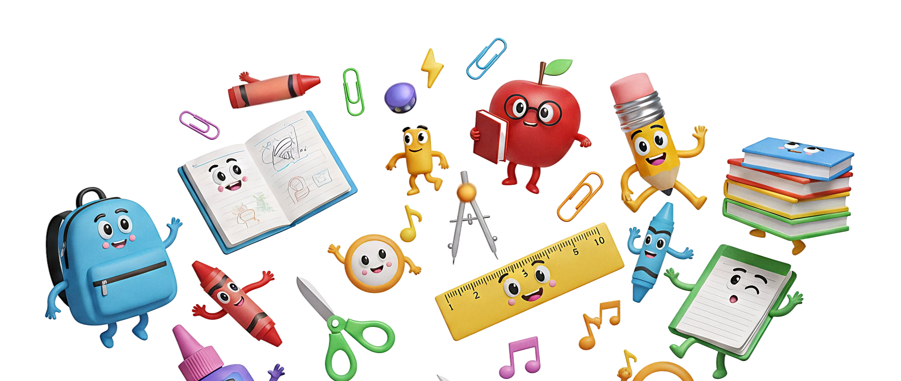
01
02
03
Three ideas
Mercury is the closest planet to the Sun and the smallest one in the Solar System. This planet’s name has nothing to do with the liquid metal, since Mercury was named after the Roman messenger god
Venus has a beautiful name and is the second planet from the Sun. Its atmosphere is extremely poisonous. It’s the second-brightest natural object in the night sky after the Moon
Jupiter is a gas giant and the biggest planet in the Solar System. It’s the fourth-brightest object in the night sky and it has around eighty moons. It was named after the Roman god of the skies

Slide 8
Four ideas you need to know
01
02
03
04
This is what you need to know about Jupiter
Planet Mars is actually closer than you think
This is what you should know about Venus
These are a few interesting facts about Jupiter
It’s the fourth-brightest object in the night sky. It was named after the Roman god of the skies and lightning
Despite its red appearance, Mars is actually a cold planet. It has temperatures often reaching below freezing
Venus has a beautiful name and is the second planet from the Sun. Its atmosphere is extremely poisonous
Jupiter is a gas giant and the biggest planet in the Solar System. It’s the fourth-brightest object in the night sky

Slide 9
Let’s show some data
333,000
12,742 km
386,000 km
24 hours
How many times the Sun’s mass is compared to Earth’s
The average diameter of Earth at the equator
The distance between Earth and the Moon
The duration of a full rotation of Earth (1 day)

Slide 10
A timeline always works well
01
02
03
04
05
This is Venus
This is Earth
This is Mars
This is Jupiter
This is Saturn
Venus has a beautiful name and is the second planet from the Sun. It’s terribly hot, even hotter than Mercury
Earth is the third planet from the Sun and the only one that harbors life in the Solar System
Despite being red, Mars is actually a cold place. It’s full of iron oxide dust, which gives the planet its reddish cast
Jupiter is the fourth-brightest object in the night sky. It was named after the Roman god of the skies and lightning
Saturn is a gas giant and has several rings. It’s composed mostly of hydrogen and helium

Slide 11
Infographics are useful
Mars
Mars is a red planet
Mercury
Mercury is very small
Venus
Venus is a hot planet
Jupiter
Jupiter is a gas giant

Slide 12
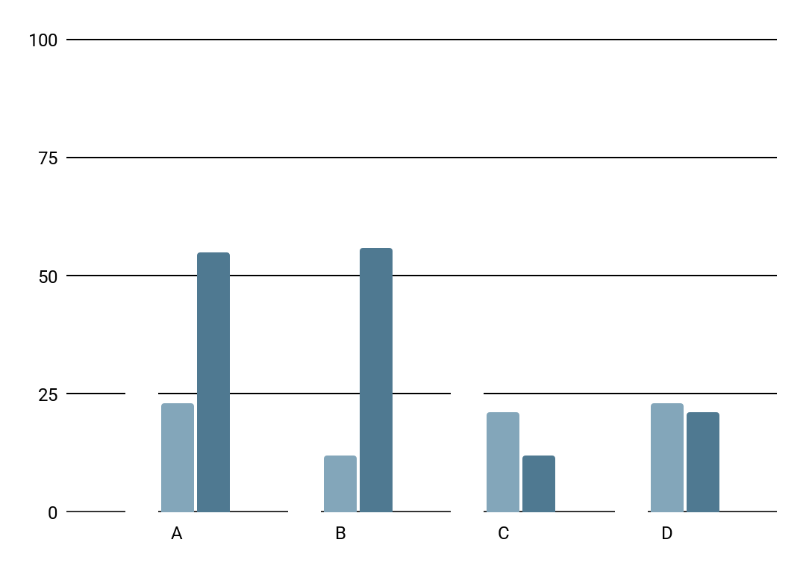
You can use tables and charts
Mercury is the closest planet to the Sun and the smallest one in the Solar System—it’s only a bit larger than the Moon
 |  | A | B | C | D
 | Mercury | 0.06 | 0.53 | 0.38 | 0.38
 | Mars | 0.11 | 9.4 | 0.53 | 0.78
 | Saturn | 95.2 | 1.16 | 9.4 | 1.16
Follow the link in the graph to modify its data and then paste the new one here. For more info, click here

Slide 13
Thanks!
Do you have any questions?
youremail@freepik.com
+00 000 000 000
yourwebsite.com
Please keep this slide for attribution

